Slide 1
Algorithms to Solve Mazes
An Application of Graph Theory
Jonathan Garofalo
May 4, 2017
Mount Saint Mary College
Coordinating Seminar

Slide 3
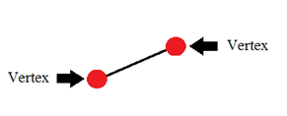
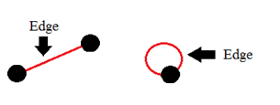

Slide 4
Representing a Maze Graphically
Vertex at Junction of 3 or More Paths
Vertex at Each Dead End
Vertex at Start
Vertex at End
Edges Between Each Vertex as Connecting Paths

Slide 5
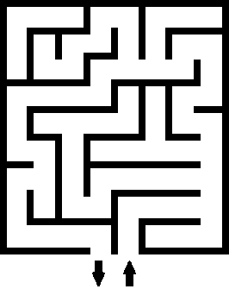

Slide 6
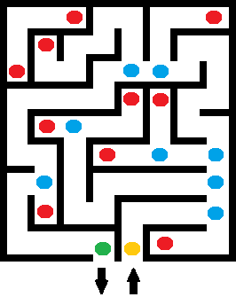

Slide 8
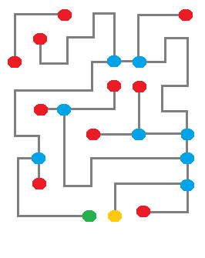
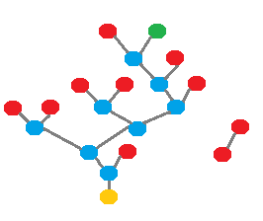

Slide 9
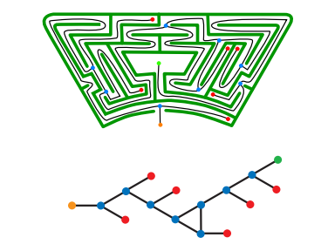

Slide 10
Maze Solving Algorithms
Wall Follower (Left/Right Hand Rule)
Trémaux's Algorithm
Dead End Filling
Shortest Path
Breadth First
“Greed”

Slide 11
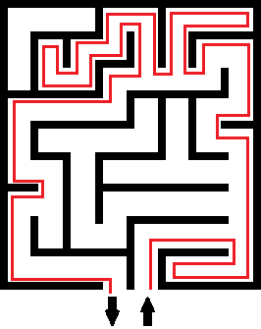
Wall Follower
Follow the Right or Left Wall
Works if Simply Connected
Entrance/Exit are on the outer boundary
Works in 3D if:
Maze can be projected to a 2D plane
“Up” is “northwest”
“Down” is “southeast”

Slide 12
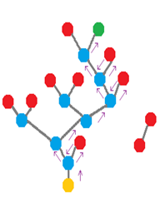
How Does This Work?
Side Preference
Ability to “Turn Around”
Undirected Graph Edge Properties

Slide 13
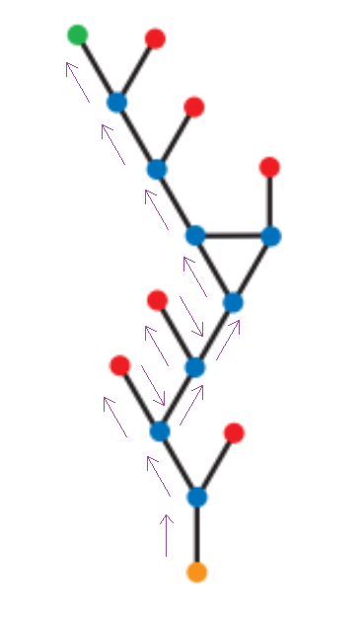
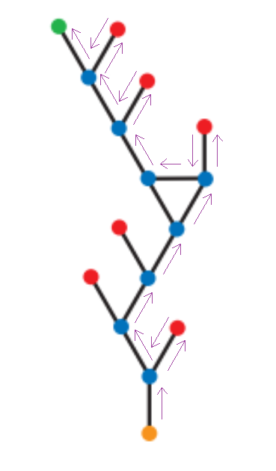

Slide 14
Trémaux's Algorithm
Mark a Path Once When You Follow it
Never Enter a Path with Two Marks
Junction with No Marks
Arbitrarily choose an unmarked path
Dead End
Turn around and mark the path again
Junction with Marks
Arbitrarily choose a path with the least marks

Slide 15
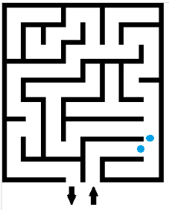

Slide 16
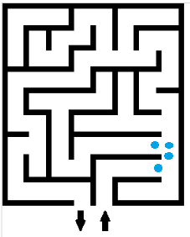

Slide 17
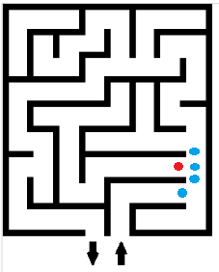

Slide 18
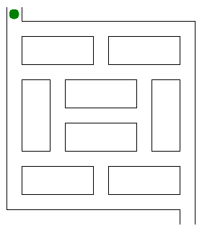

Slide 19
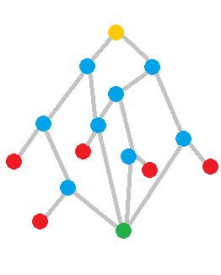
Mazes With More Than 1 Exit
Wall Following And Trémaux's Algorithm Will Still Work
May Not Find the Shortest Path

Slide 20
Shortest Path Breadth First
Start at Tree Root
Explore Neighbors
Moves onto Next Level

Slide 21
Original Algorithm

Slide 22
Original Algorithm

Slide 23
Original Algorithm

Slide 24
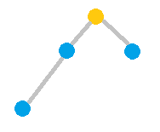
Original Algorithm

Slide 25
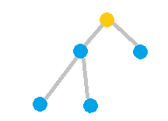
Original Algorithm

Slide 26
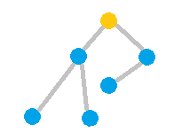
Original Algorithm

Slide 27
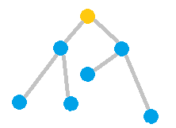
Original Algorithm

Slide 28
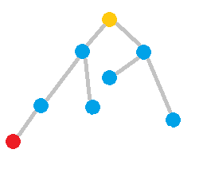
Original Algorithm

Slide 29
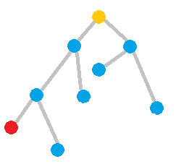
Original Algorithm

Slide 30
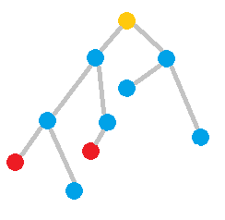
Original Algorithm

Slide 31
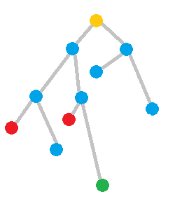
Original Algorithm

Slide 32
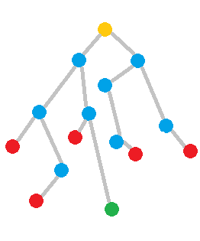
Original Algorithm

Slide 33
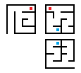
3D Mazes

Slide 34
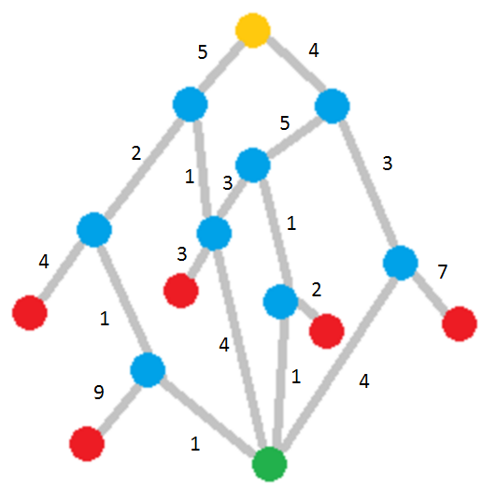
Weighted Paths
Greed is Good Algorithm
Find the Pieces
Breadth First

Slide 35
Other Applications of the Algorithms
Reducing Costs of Networks
Delivery routes
Shipping routes
Game Design and Testing

Slide 37
Works Cited
"The Breadth-first Search algorithm." Khan Academy. N.p., n.d. Web. 02 May 2017. <https://www.khanacademy.org/computing/computer-science/algorithms/breadth-first-search/a/the-breadth-first-search-algorithm>.
"Graph." Graph -- from Wolfram MathWorld. N.p., n.d. Web. 01 May 2017. <http://mathworld.wolfram.com/Graph.html>.
"Solving a Maze." Building Robots with LEGO Mindstorms NXT (2007): 327-48. Stanford.edu. Web. 1 May 2017. <http://web.stanford.edu/~yinoue93/docs/Maze%20Solving.pdf>.
"Threading Models." Pro .NET 1.1 Remoting, Reflection, and Threading (n.d.): 519-33. Pro .Net. Web. 2 May 2017. <http://www.cems.uvm.edu/~rsnapp/teaching/cs32/lectures/tremaux.pdf>.
Vol. 2, No. 2, July-December 2011, Pp. 445-449. A NEW SHORTEST PATH FINDING ALGORITHM FOR A MAZE SOLVING ROBOT WITH SIMULATOR (n.d.): n. pag. CSJournals. CSJournals. Web. 2 May 2017. <http://csjournals.com/IJCSC/PDF2-2/Article_31.pdf>.

Slide 38
Images
http://www.b2b-im.com/wp-content/uploads/2014/12/question-mark-in-maze-shows-confusion_fkWJuMvu.jpg
https://upload.wikimedia.org/wikipedia/commons/thumb/1/11/Tremaux_Maze_Solving_Algorithm.gif/220px-Tremaux_Maze_Solving_Algorithm.gif
http://www.cems.uvm.edu/~rsnapp/teaching/cs32/lectures/tremaux.pdf

